Slide 2
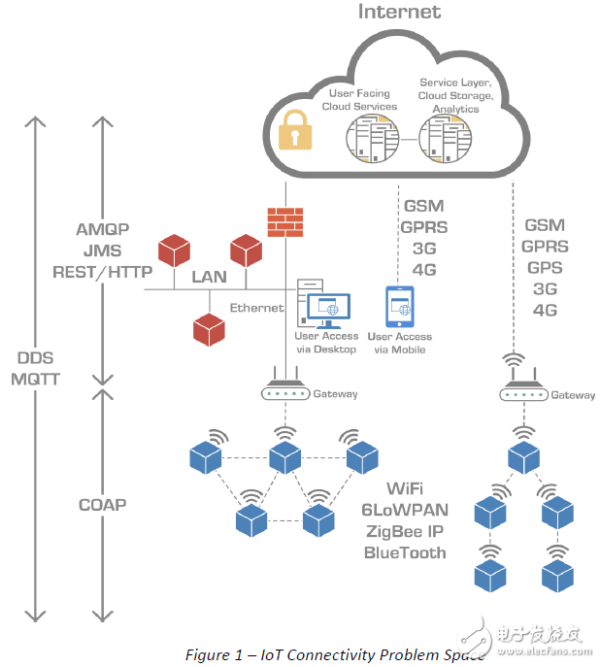

Slide 3
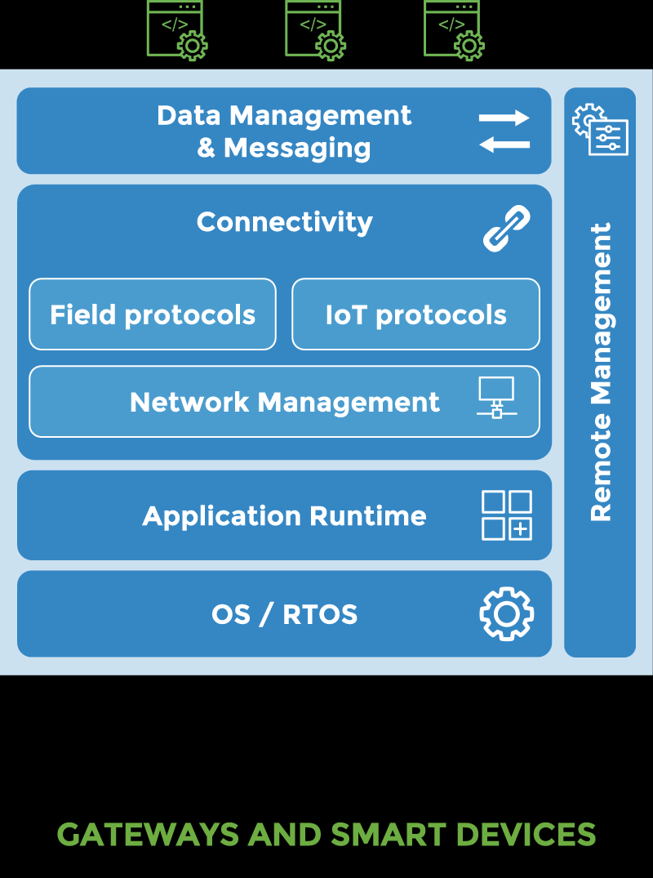
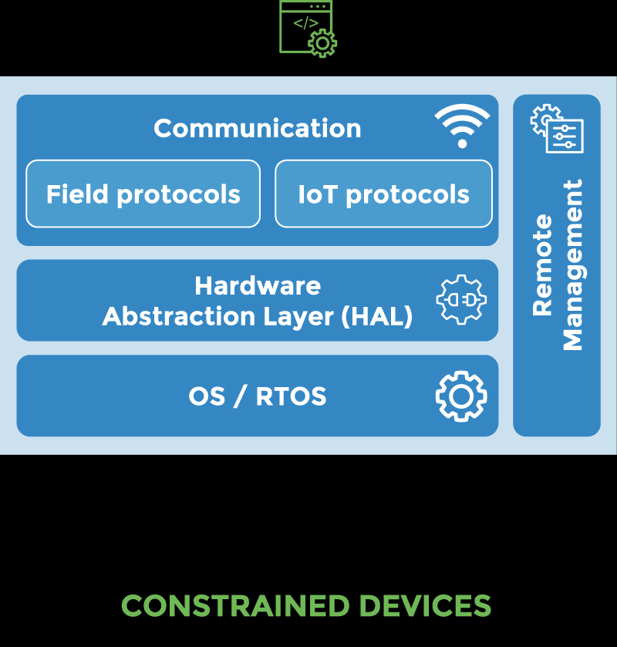

Slide 4
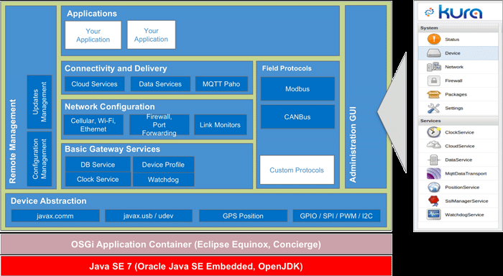

Slide 5
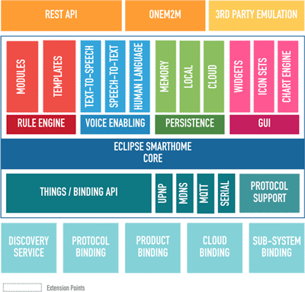

Slide 6
cloud
Kapua
OM2M
Hono
Mosquitto
Leshan
hawkBit
BIRT
Hono
Gateway
Eclipse qura
smart home
4diac
Eclipse Wakaama
remote
mgmt
MQTT Client
Eclipse paho
GPU
Eclipse edje
GPIO, ADC, MEMS, etc

Slide 7
https://iot.eclipse.org/getting-started
mqtt
oneM2M
OMA LWM2M

Slide 8
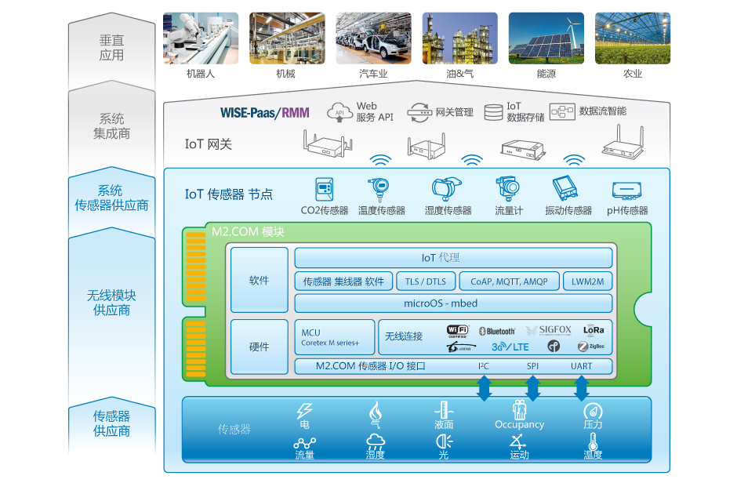

Slide 9
